Slide 1
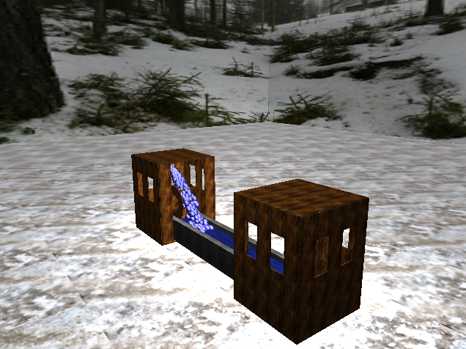
COMPUTER GRAPHICS FINAL PRESENTATION
ZAVEN MNATZAKANIAN

Slide 2
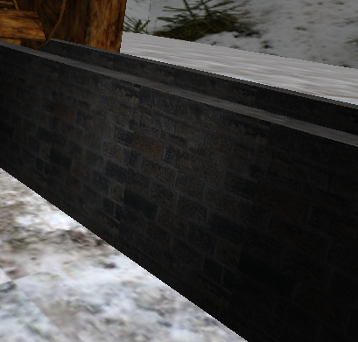
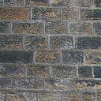
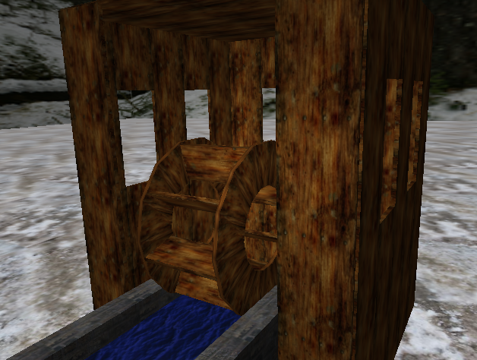
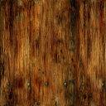
REPEATING TEXTURES
Brick and wood textures repeat to create a textures objects
Use a combination of a washer and a box to create a water wheel

Slide 3
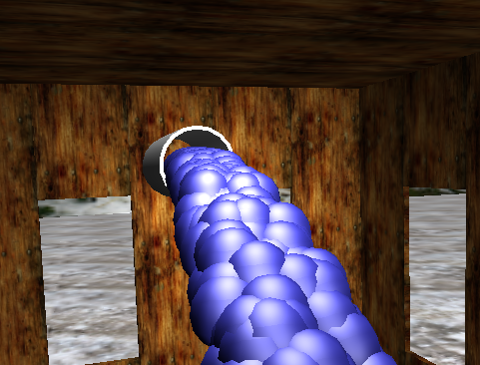
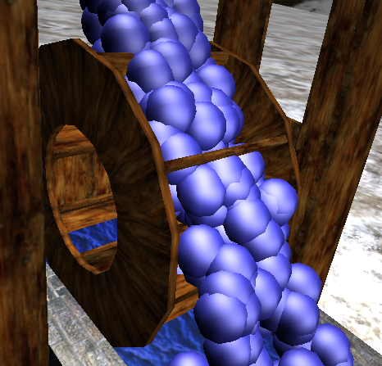
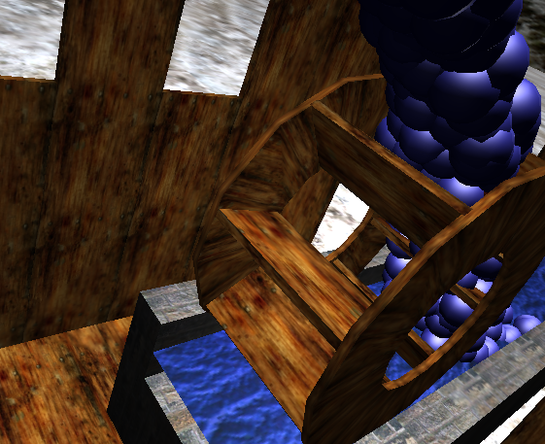
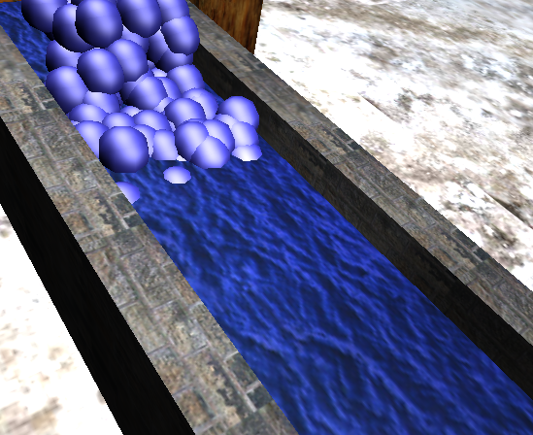
PARTICLE SYSTEM
Water generated at the pipe
Water turns the wheel and powers the lights
Water hits the water surface and moves the water texture

Slide 4
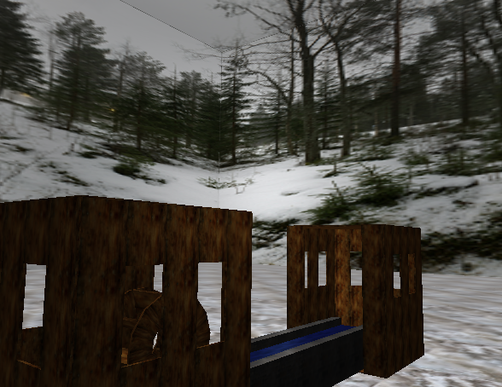
SKYBOX
Textures mapped to the walls to make the scene appear to go on longer than it is

Slide 5
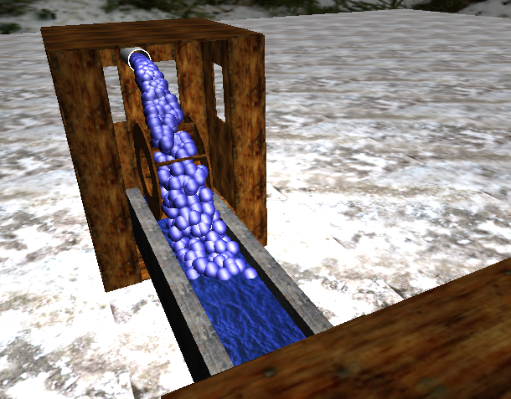
THANK YOU

